Slide 1


Git Basics Commands

Slide 2

Agenda
Git Version
Git config
Git init
Navigating through folders in the terminal
Git remote add
Git remote show
Git pull
Git clone
The working areas
Git add
Git commit
Git push
Git branch

Slide 3
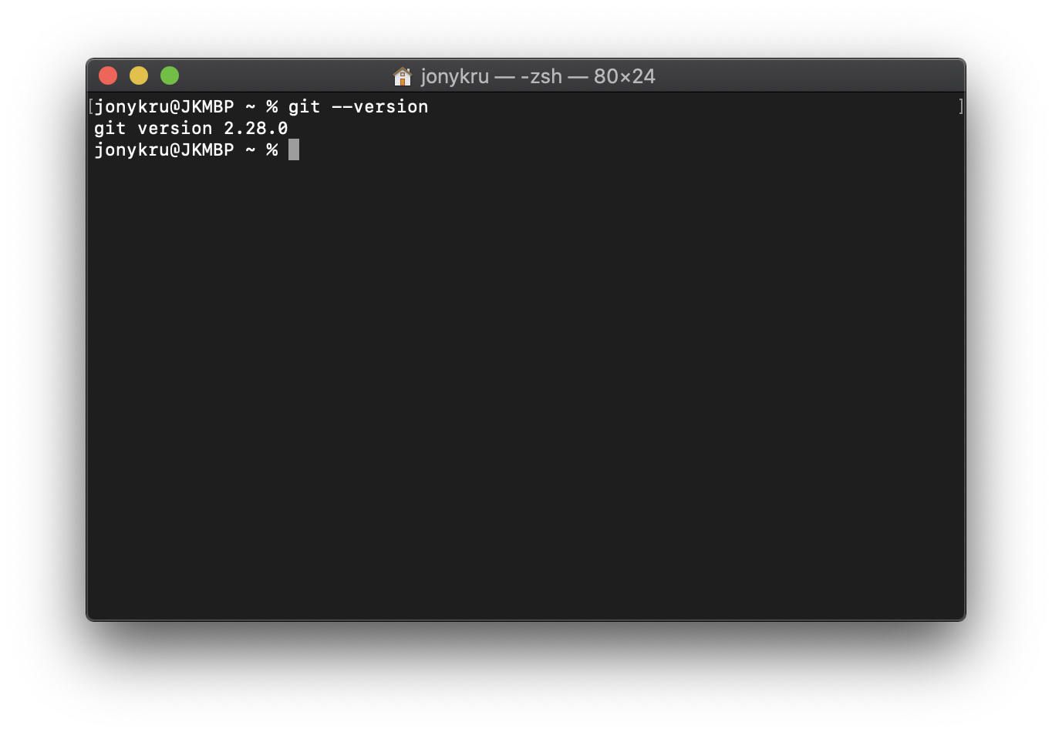
GIT Version
git --version

Slide 4
GIT config: Tell git who you are
For first and only time, let’s set up who we are for git.
Name: Should be your git username
Email: Should be the same email you used for creating your github account.
git config --global user.name "<YOUR_USER>"
git config --global user.email "<YOUR_ACCOUNT_EMAIL>"
To see only the value, don’t pass a string as parameter:
git config -- global user.email => Will show only the email

Slide 5
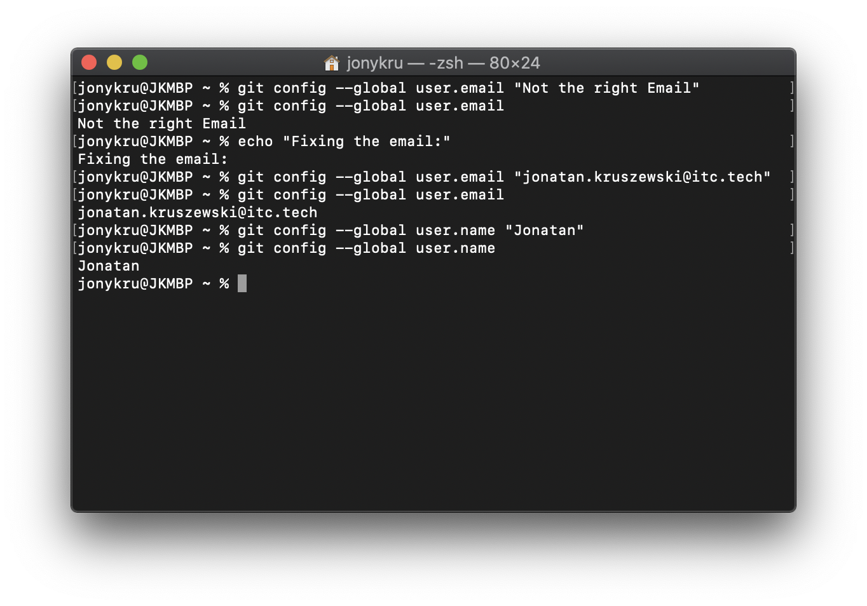
GIT config: Tell git who you are
Let’s seth both settings:
git config --global user.name "<YOUR_USER>"
git config --global user.email "<YOUR_ACCOUNT_EMAIL>"

Slide 6
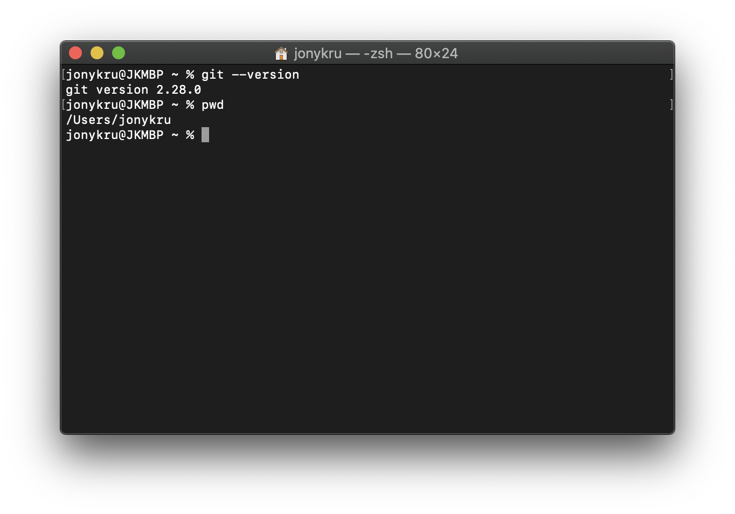
Navigating to a directory
Terminal windows are always open at a directory. If you see this symbol (named tild):
~
It means you are in your ‘HOME’ directory. You can check the address of that directory by using:
pwd

Slide 7
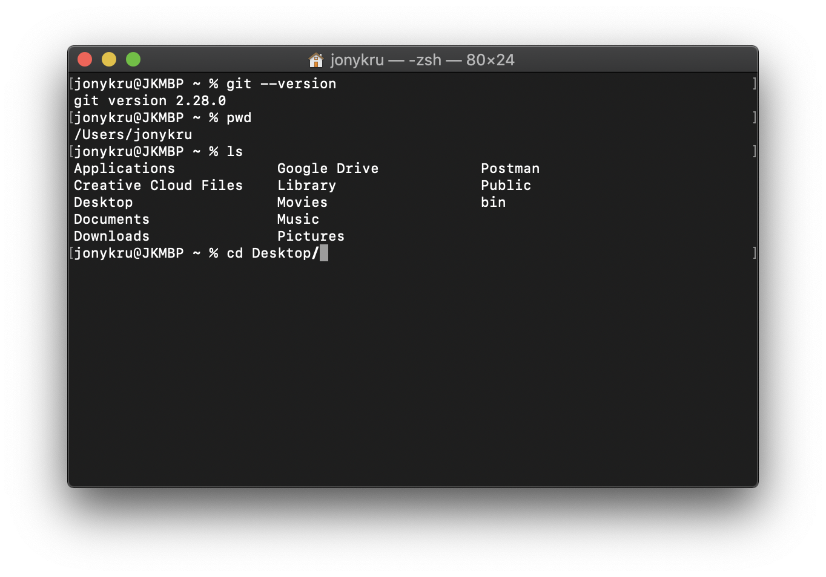
Navigating to a directory
You can change the directory that you are working at by using the command ‘cd’. You can ‘cd’ to an existing folder inside your current location. Hitting <tab> key in your keyboard would autocomplete you the full name
cd desk + tab === cd Desktop/
You can repeat this process for folders inside Desktop for example.

Slide 8
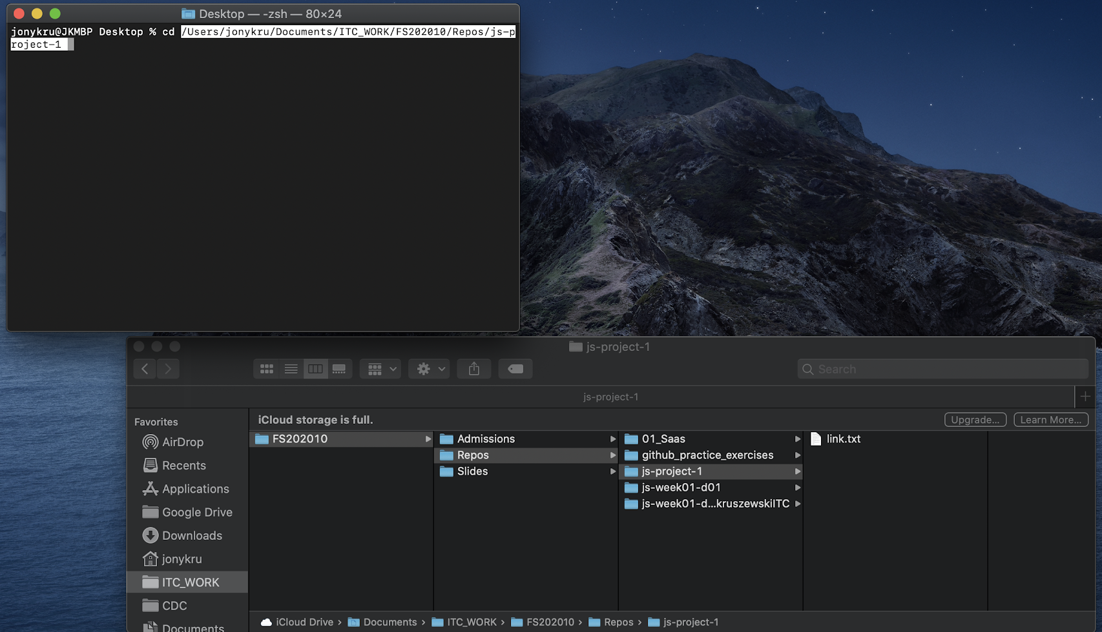
Navigating to a directory
👈 You can copy a full path and paste it afterwards cd (might need quotation marks in Windows), or drag a folder to it (Mac)
‘cd’ also can accept a full path not linked to the folders inside your current location:
cd ~/Users

Slide 9
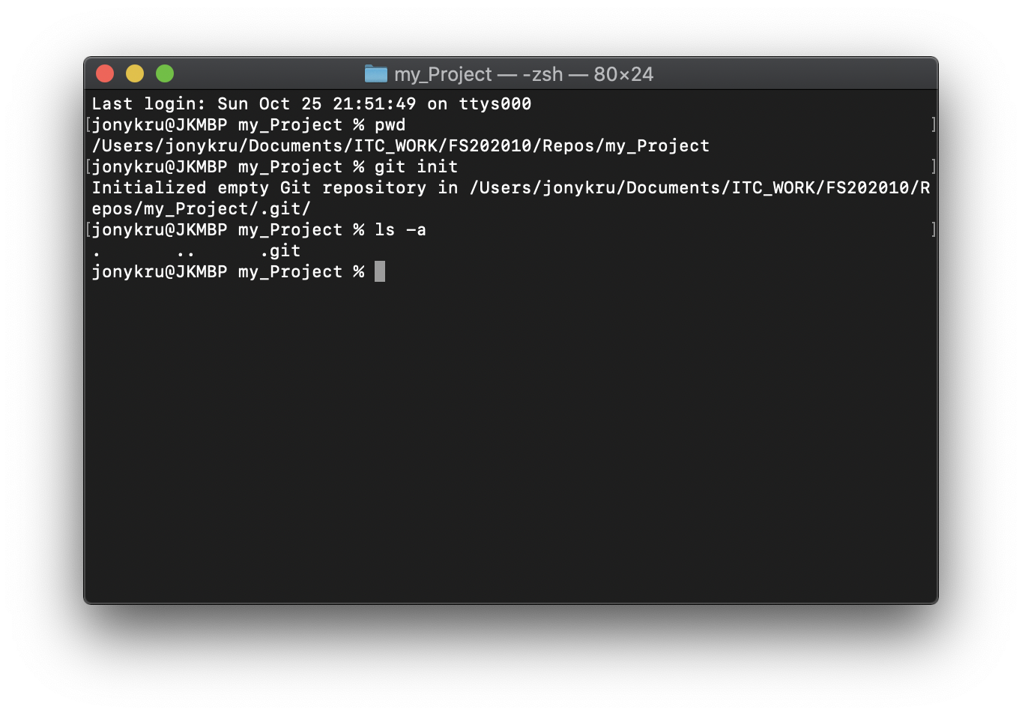
GIT init
Once you are in the folder you want to create your project (or that you have already created) you need to run:
git init
To initialize a git repository. This repository for now it only lives in your computer.
This command will create a hidden folder “.git” that inside will contain all the files git needs to handle the Version Control System.

Slide 10
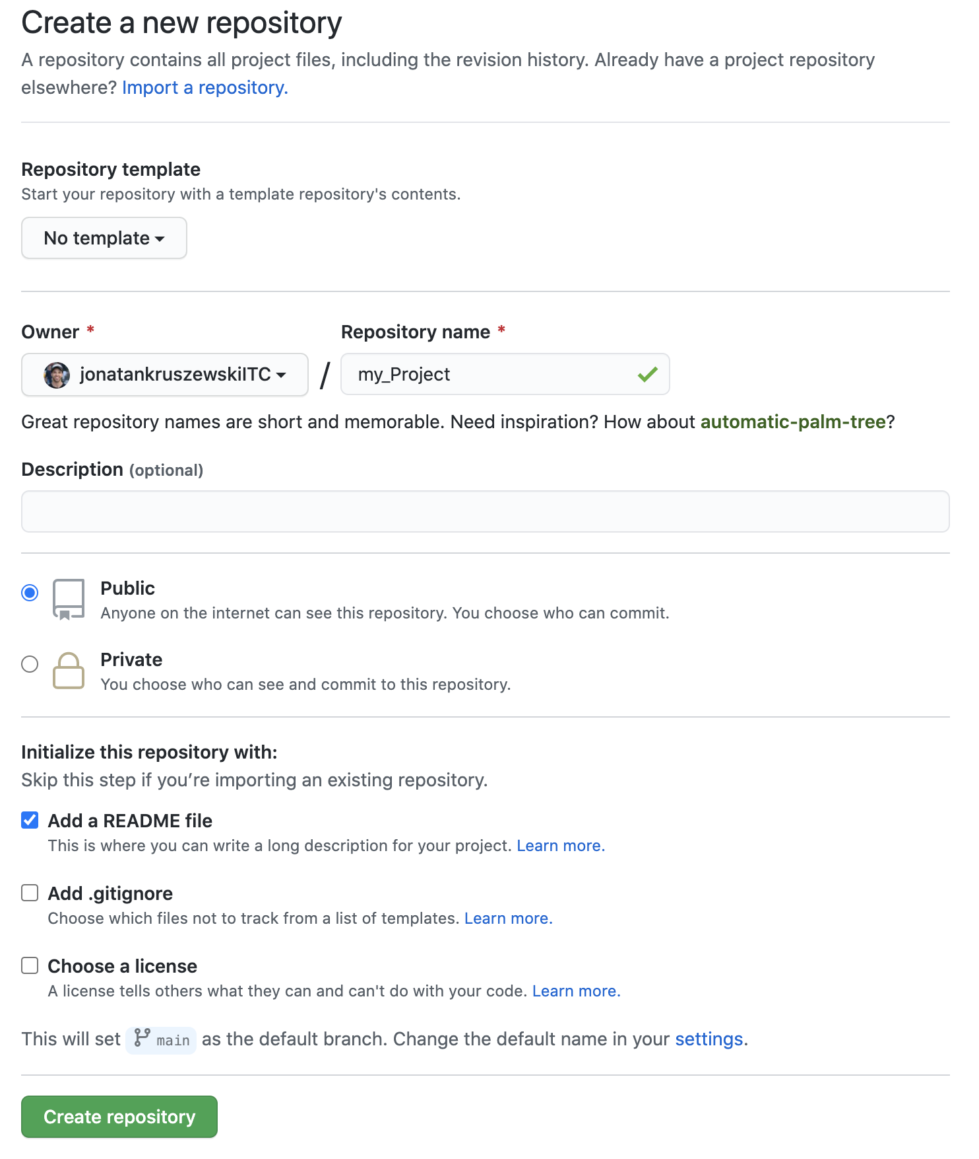
Creating an online Repository
Before connecting to a remote repository, we need to have one.
For that, we are going to create it.
In this case, we do want it with a readme file beforehand, so let’s check that option.
Have a look at it is specifying that our default branch is going to be named ‘main’. Before it used to be called ‘master’ so be aware how your default branch is named.

Slide 11
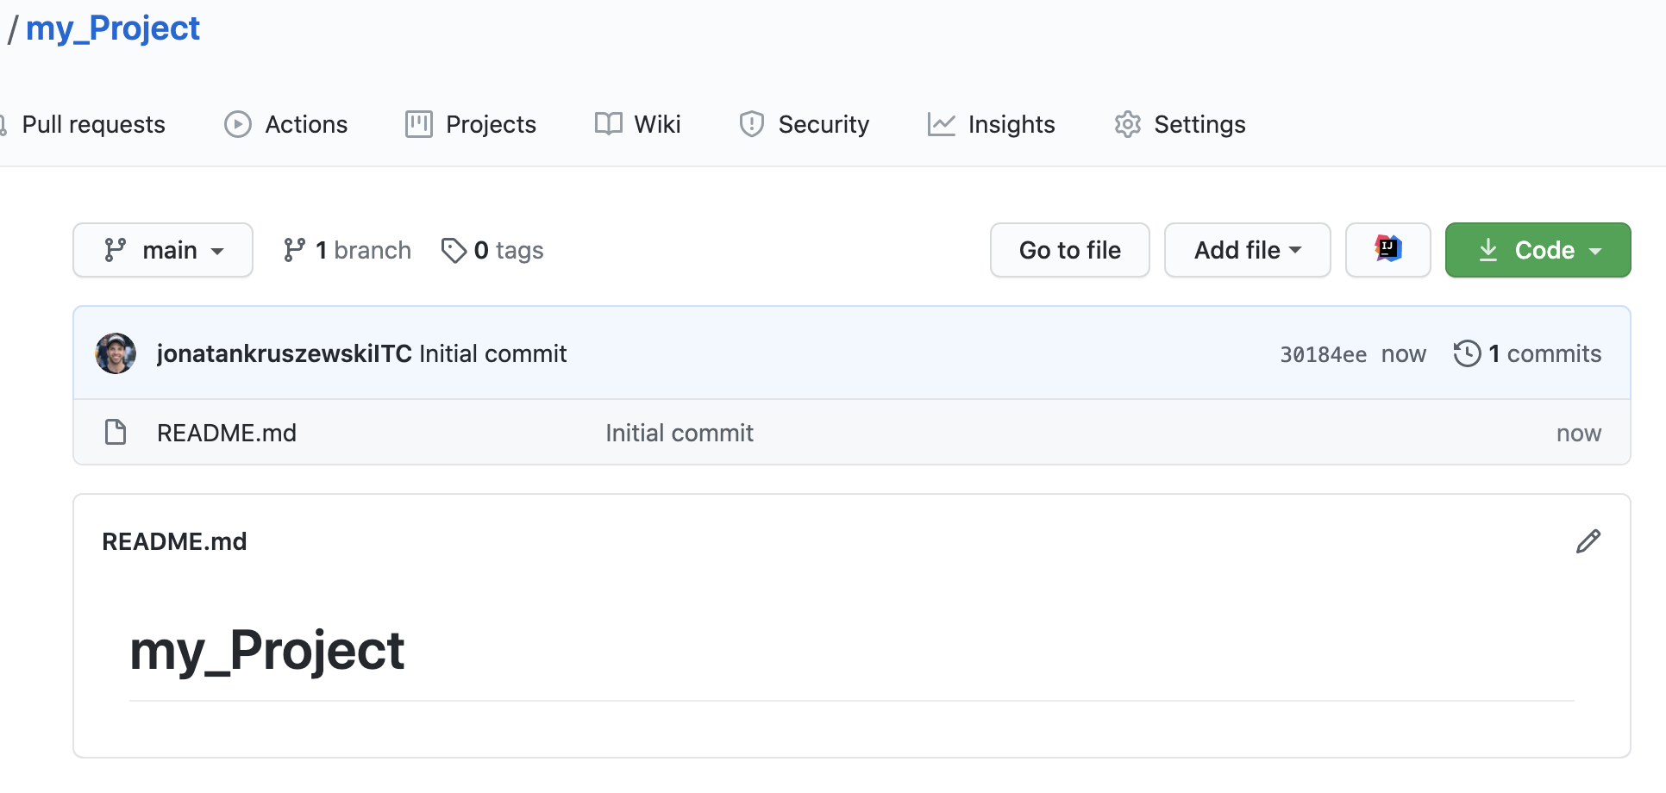
Creating an online Repository
Afterwards creating it, we have our repository with the readme:

Slide 12
GIT remote
The command git remote allows us to manipulate the connection to an online repository. The online repositories are called remotes. Remotes differ from local repositories: the remotes can be accessed by more than one user, while the local, only lives in your computer and no one else has access.
With git remote we can link our local repository to an online one (git remote add), show our remotes (git remote show), modify it URL addresses, etc.
Let’s see some basics.
To add a new remote, we will need to provide it a name (conventionally, origin) and its address grabbed from our repo -previously created- (remember to use HTTP / SSH properly):
git remote add <name_of_remote> <url_of_the_remote>

Slide 13
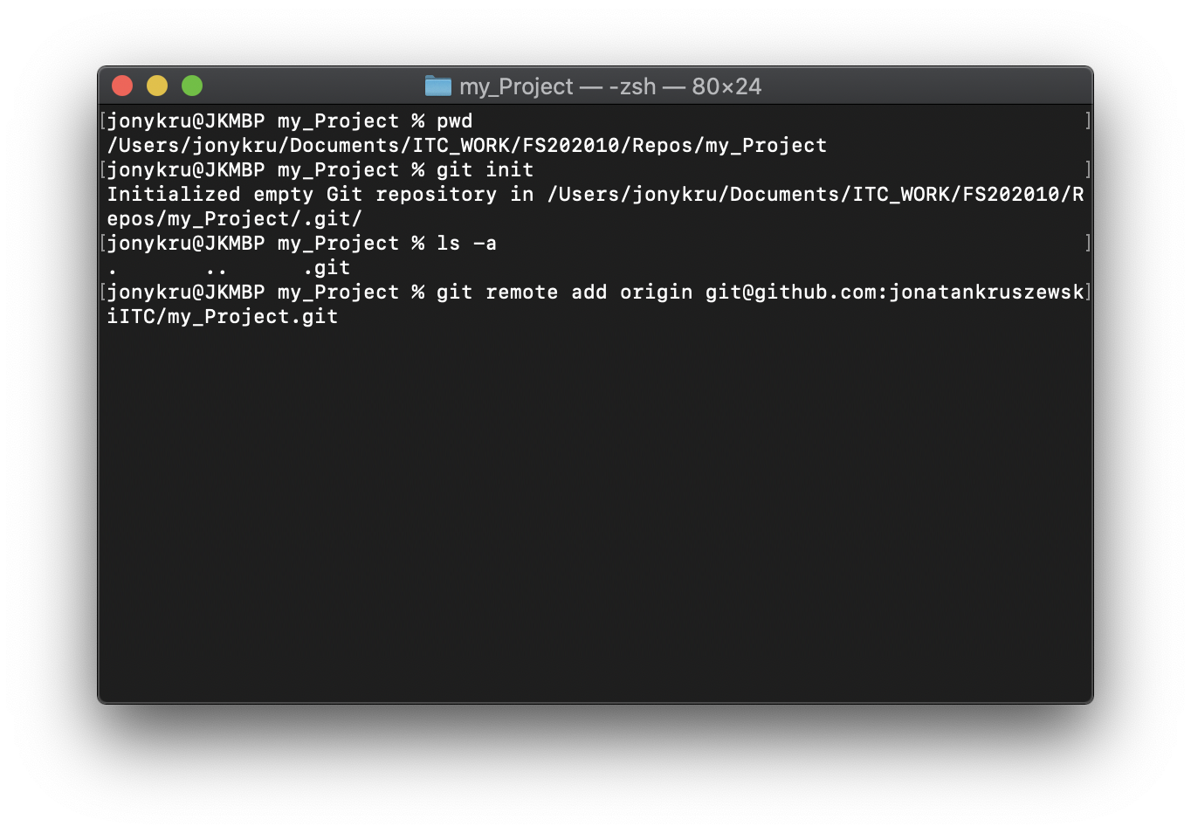
GIT remote add
In this case, you can notice that the remote is being added by using the SSH method because it looks like:
git@github.com:<user>/<repository_name>.git
HTTPS methods look like:
https://github.com/<user>/<repository_name>.git

Slide 14
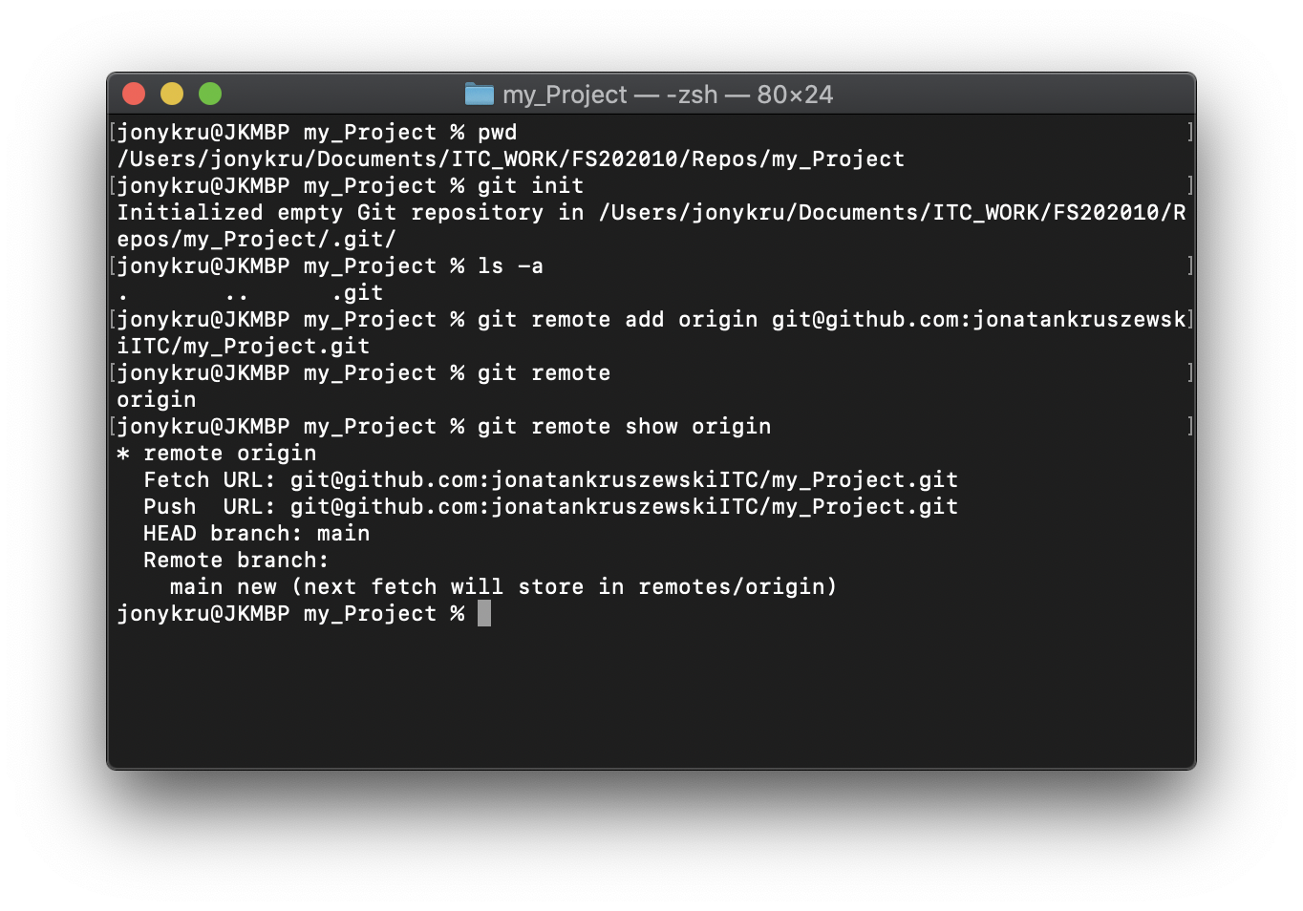
GIT remote show
After adding a remote, git remote will show that we have a remote named origin:
git remote
We can expand details about that remote by typing:
git remote show origin
Pay attention that this command is showing the name of our remote branch (main)

Slide 15
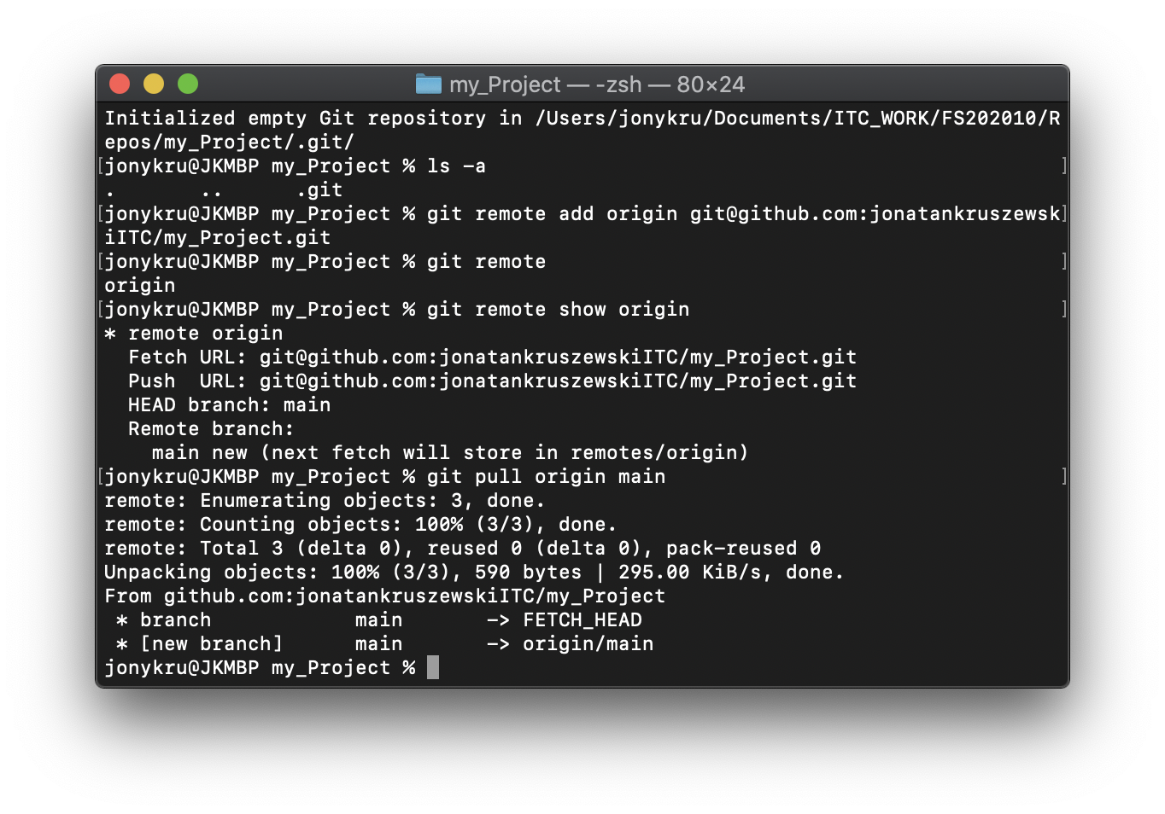
GIT pull
Afterwards linking the local with the remote, we are allowed to bring the remote’s code 😊. We will do it by using:
git pull origin <branch_name>
It performs 2 operations:
git fetch
git merge
What does that mean? It means that is grabbing the code from the remote (fetch) and then, incorporating to ours (merge).

Slide 16
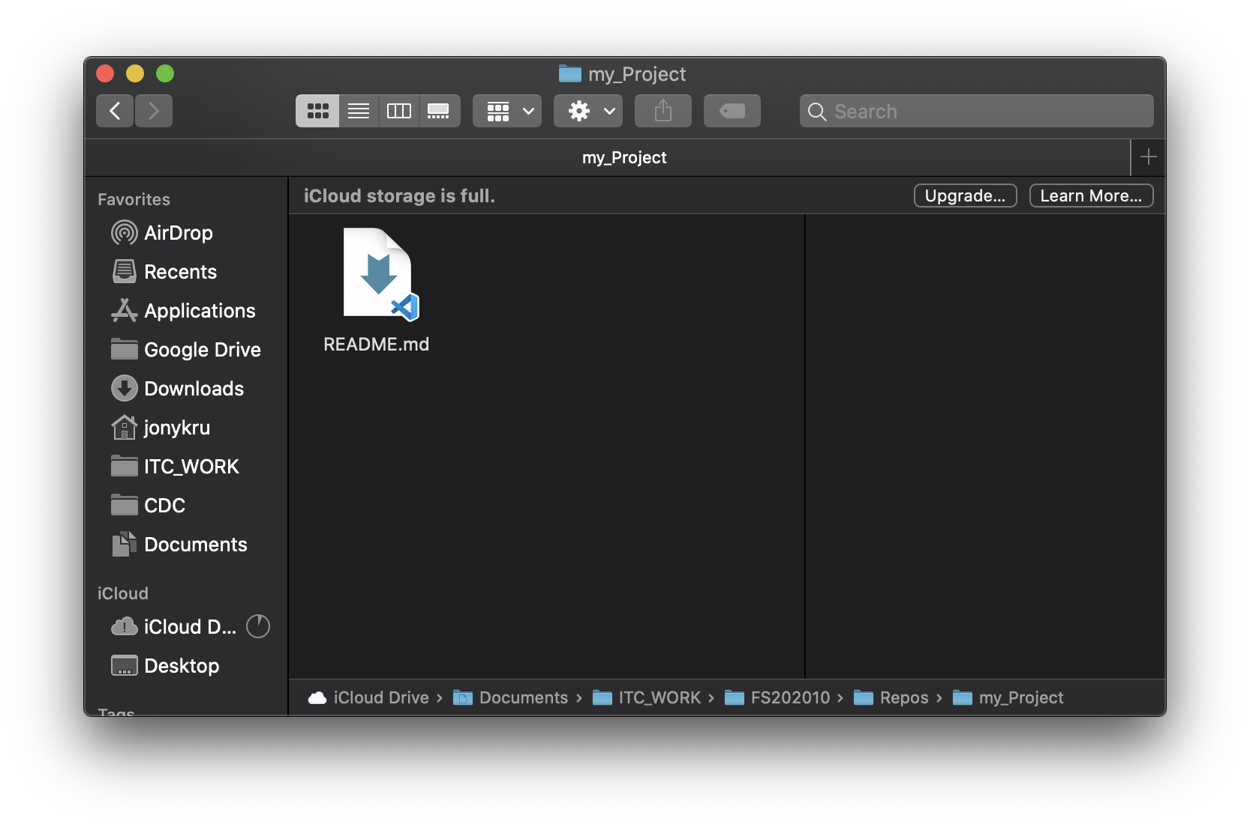
GIT pull
After pulling, the fetched and merged files can be seen on our project folder 😊.

Slide 17
GIT clone
Could we have saved some time on doing these 3 commands?:
git init
git remote add origin <URL>
git pull origin <default_branch>
Yes! By using git clone <URL>
The same way git pull performs a git fetch + git merge, git clone performs the 3 mentioned above. The only difference, is that git clone creates you a folder with the repository name and those 3 commands inside: you don’t need to create the folder, it does it for you.
So, to use git clone you actually need to be in the parent directory of the place where you want to clone the repository.

Slide 18
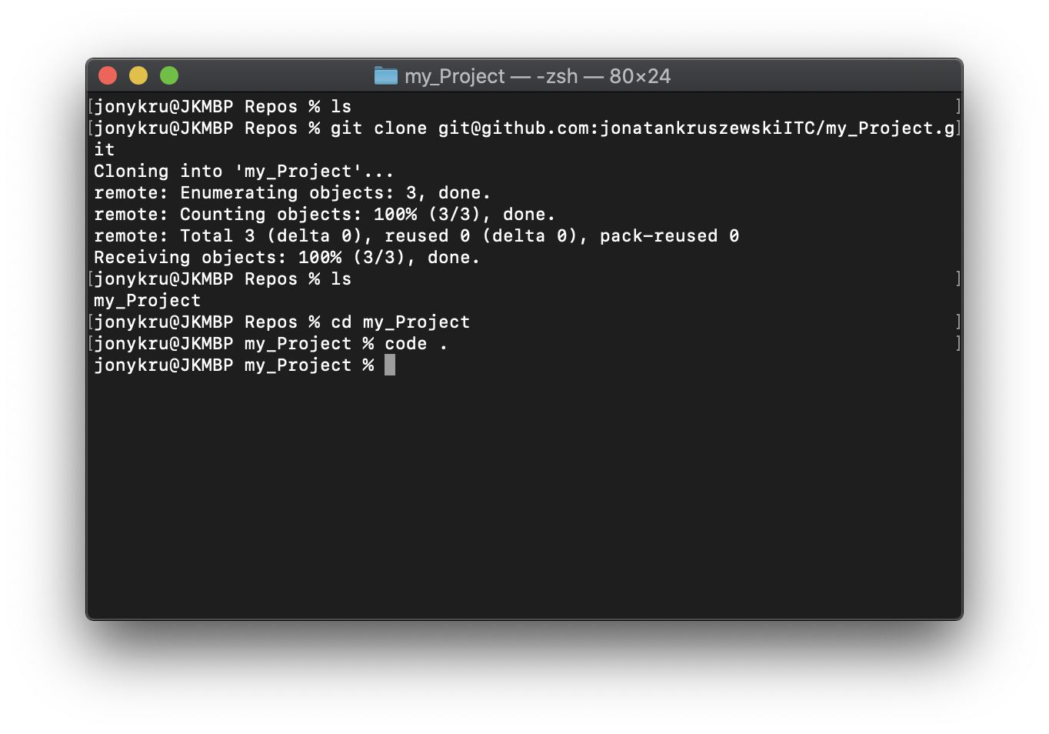
GIT clone
The Repos folder is empty before cloning. Afterwards, you can see that it contains a folder named “my_Project”
To Clone:
git clone <URL>
Let’s get inside that folder:
cd <repository_name>
Let’s open in VSC:
code .

Slide 19
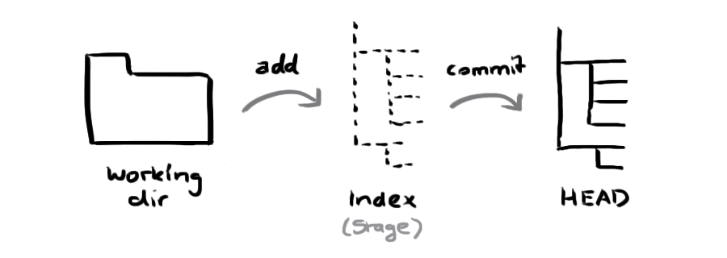
GIT workflow
Your local repository consists of three "trees" maintained by git. The first one is your Working Directory which holds the actual files. The second one is the Index which acts as a staging area and finally the HEAD which points to the last commit you've made.

Slide 20
GIT workflow
Once you have set up your local repository, linked with a remote and updated one with the other, you can start working. When you work, every time that you make progress, you should commit it.
A commit is like a snapshot of the project regarding its previous state: it stores the new changes (added/modified/deleted lines as well as files).
So, before commiting we have some stages:
Working tree clean: It means there is nothing to commit. There haven’t been changes since the last commit.
There have been changes (modifications, deletions, insertions).
There have been changes, and those changes were specified to be added to the commit (added).

Slide 21
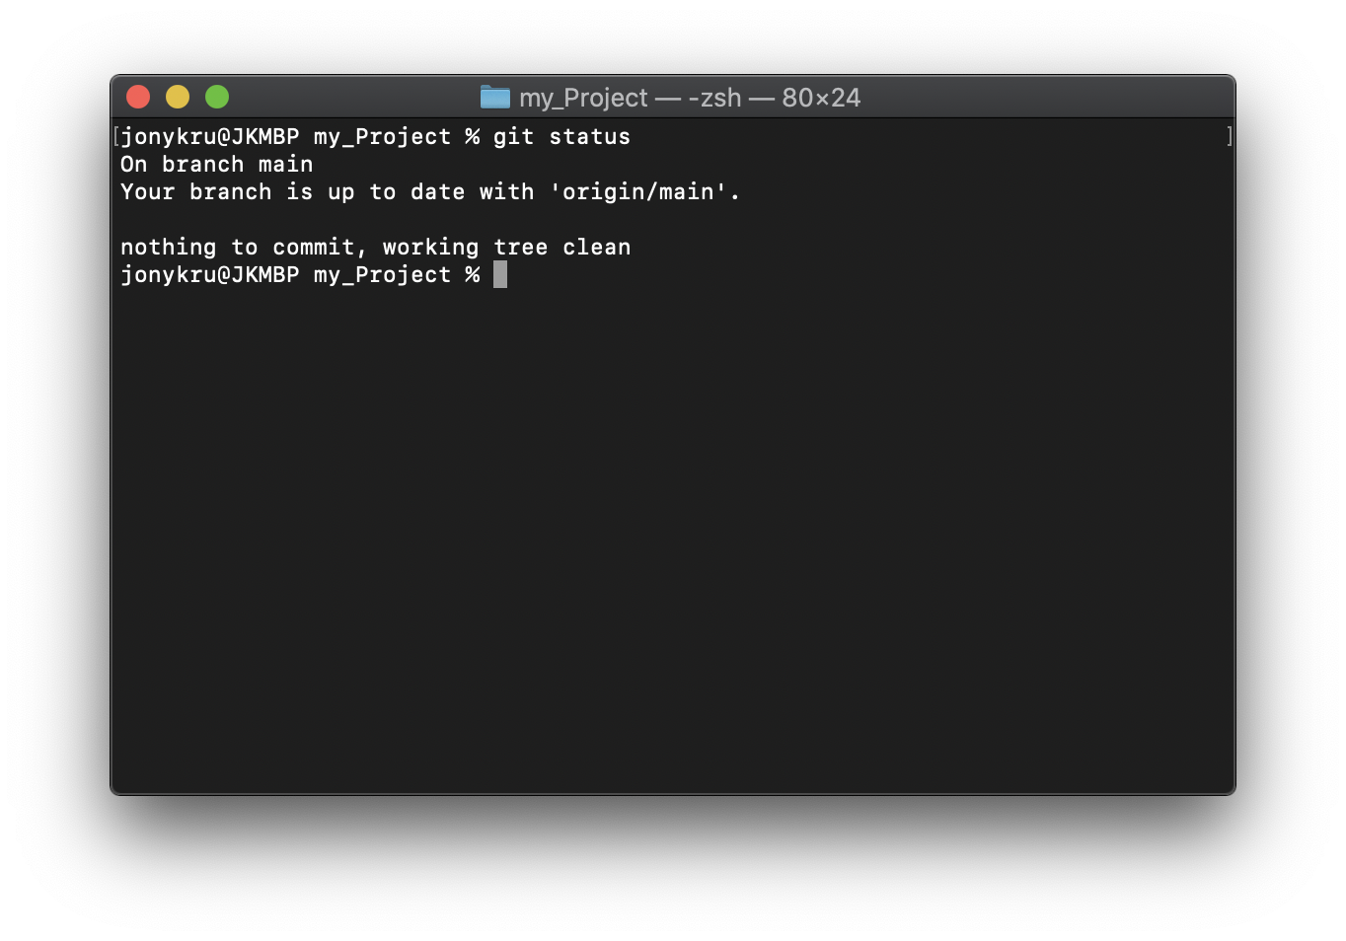
GIT status
We can know on which state of the tree we are by running
git status
We can know:
On which LOCAL branch are we working
If we need to bring commits (pull)
If we need to put commits in the remote (push).
The state of the working tree, which in this case is clean.
Let's create some modifications.

Slide 22
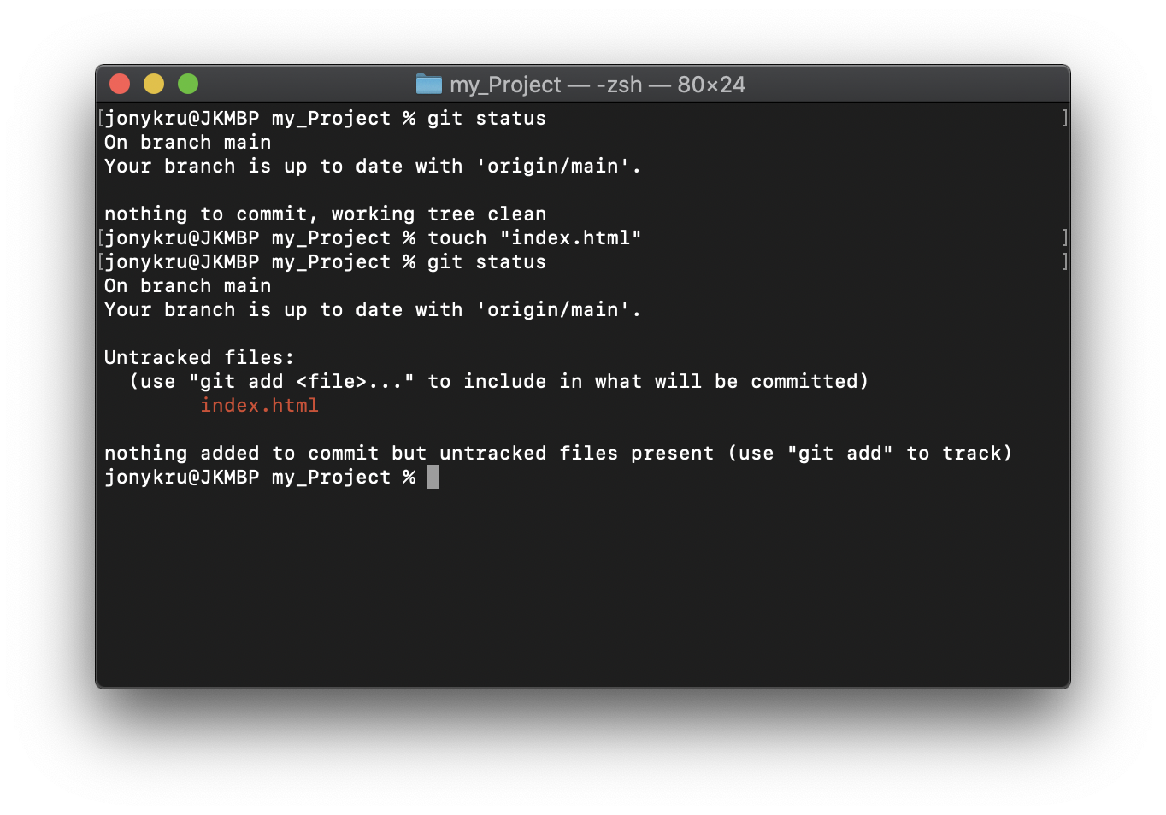
GIT status
Every modification that you make in the folder repository, git will know it.
Afterwards creating the file index.html, git status can show us what is going on with our working tree.
New files will be under ‘Untracked Files’. Modified files under ‘Modified Files’, deleted ones under ‘Deleted files’

Slide 23
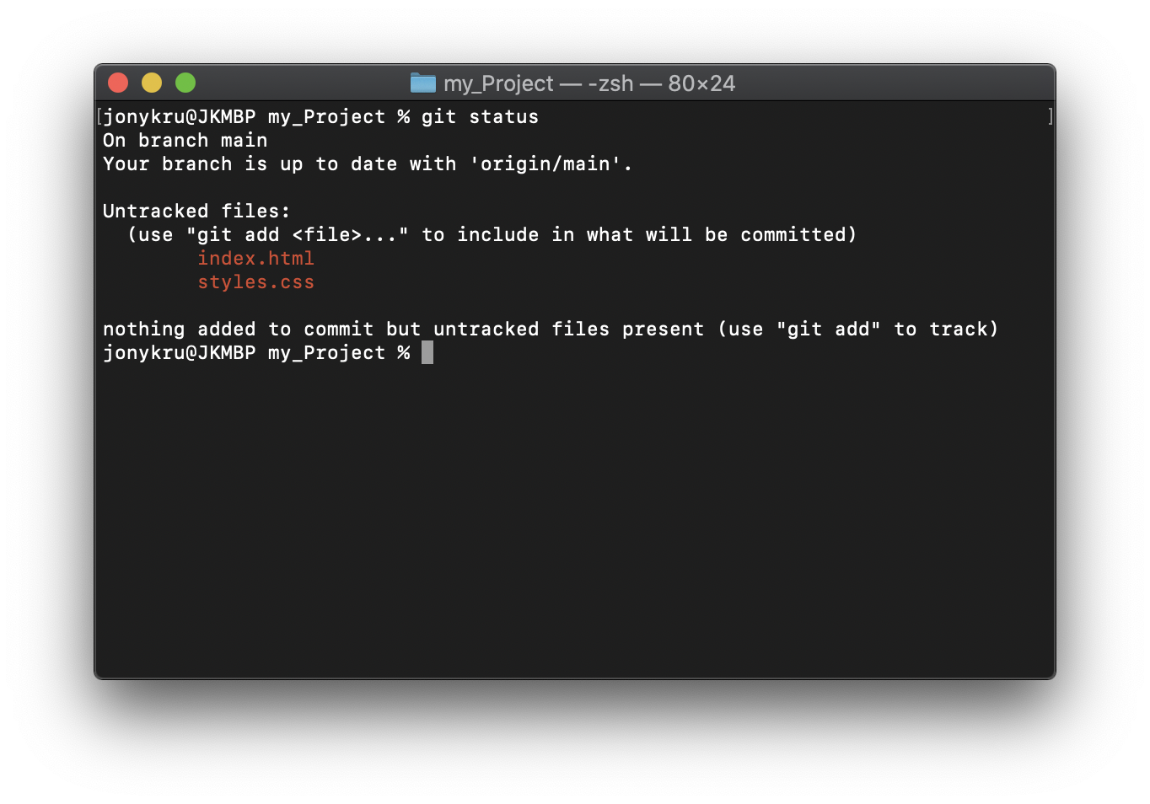
GIT status
When you are working, and performing modifications it doesn’t mean that those modifications are the ones going to be committed. You need to manually specify which of those modifications you want to add.
Let’s say that we created 2 files. Index.html, and styles.css. But we want to create one commit for each, because we work with small and clean commits.

Slide 24
GIT add
Git add allows us to tell git which files (and their modifications) we want to add to be committed (to our staging area). We can add several files or folders:
git add <file_1> <dir_1>
We can also add all the changes using any of these 2 options:
git add .
git add -A

Slide 25
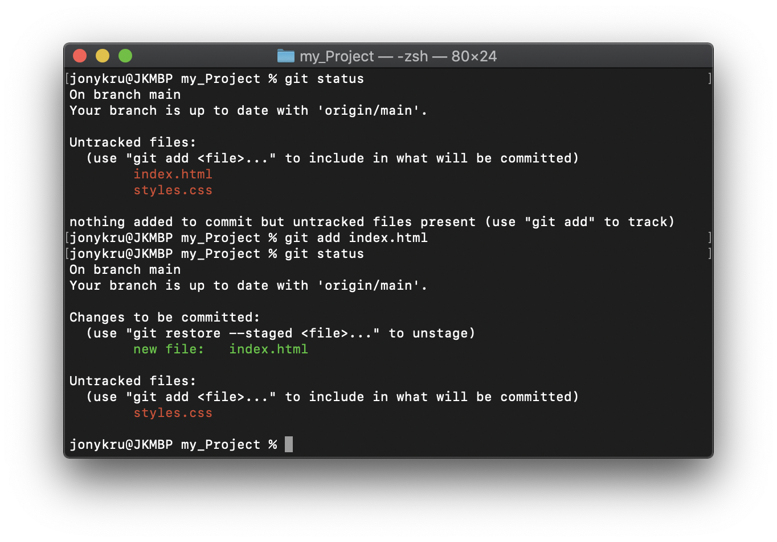
GIT add
After only adding ‘index.html’ to our staging area, we can see that if we create a commit, only index.html will be added.
Let’s create a commit!
git commit -m <some_message>
We can also add all the changes using any of these 2 options:
git add .
git add -A

Slide 26
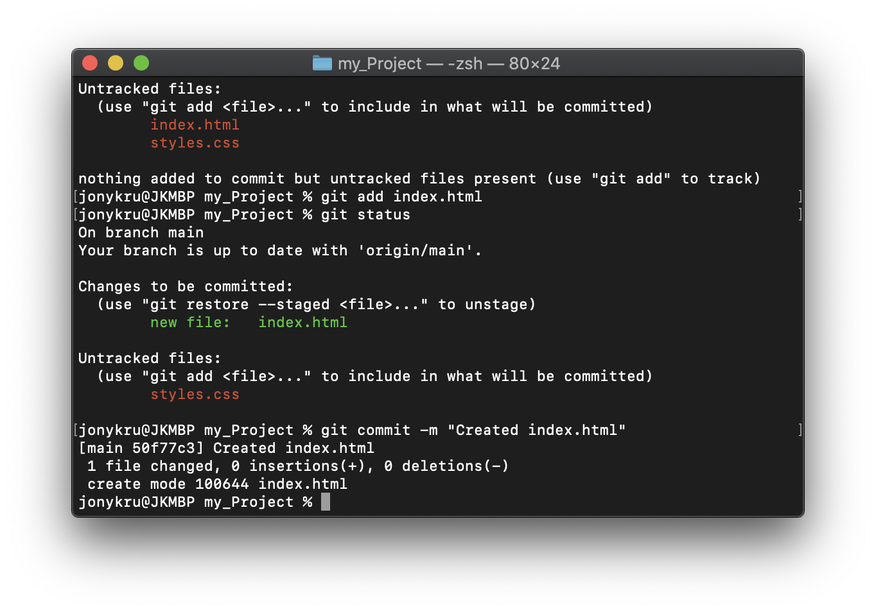
GIT commit
After some work, and adding the right files to our staging area, let’s save those changes. For that, we will create a commit:
git commit -m <some_message>
After running the command, you will get a summary of how many files were changed, how many lines added or deleted in total.

Slide 27
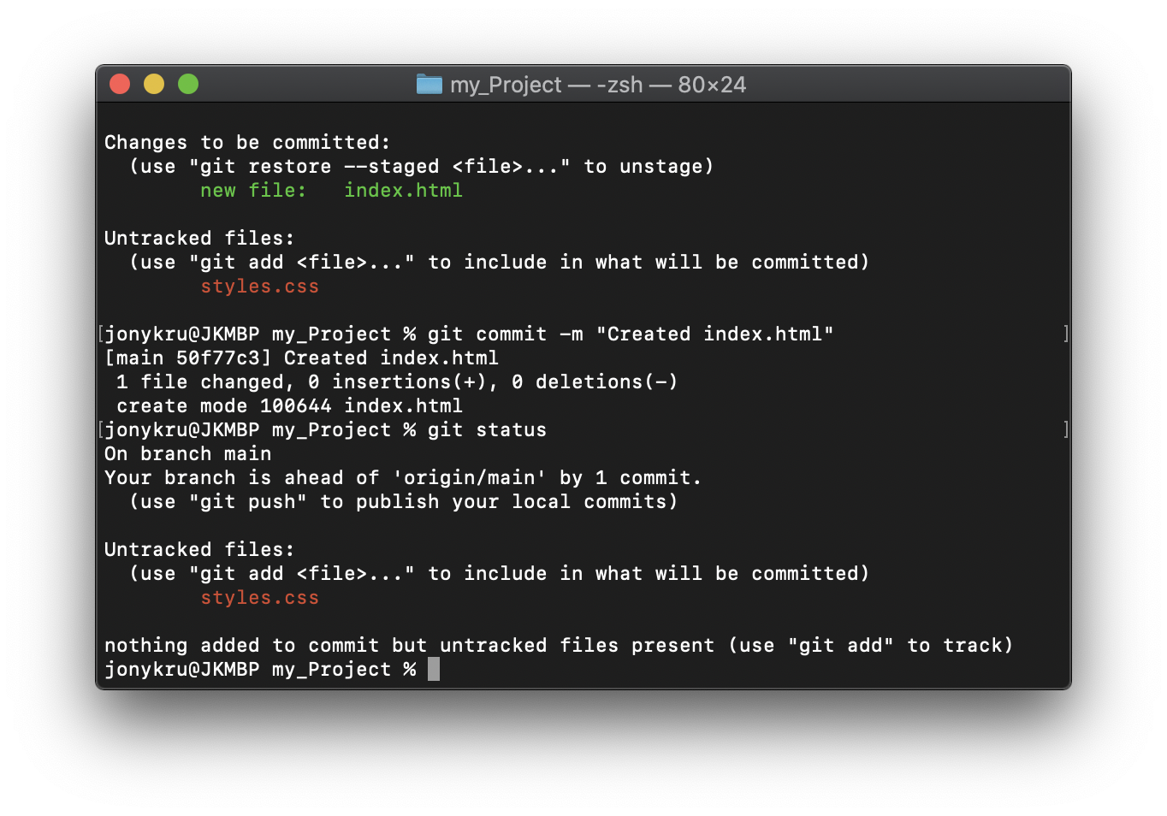
GIT commit
If we run git status again we get to see some information:
That we are ‘ahead’ of <remote>/<remote_branch>
How many commits are we ahead
That we can publish that/those commits that doesn’t exist in the remote using git push
That we still have changes in our project that haven’t been added to commit

Slide 28
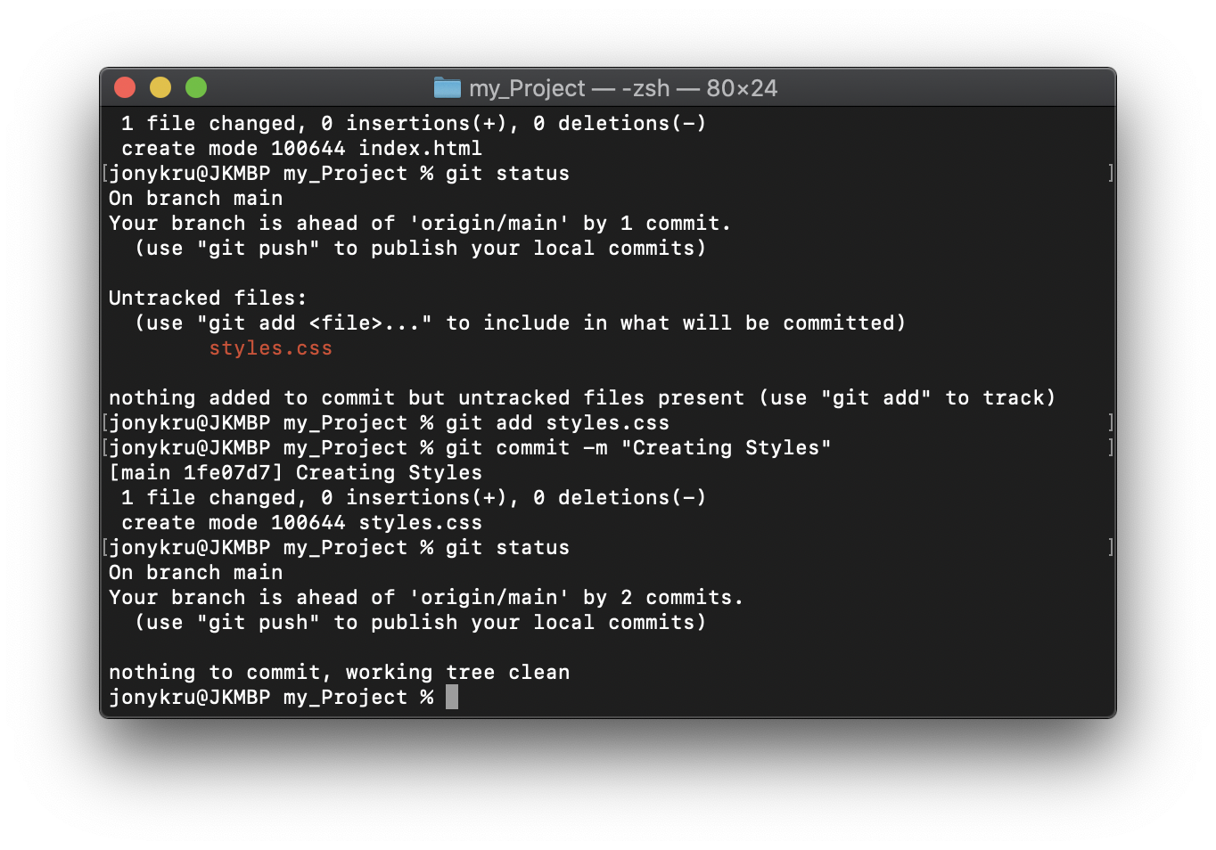
GIT commit
Let’s add also styles.css into a commit.
git add styles.css
git commit -m ‘Creating styles’
git status
Now, we know that our working tree is clean, and that we are 2 commits ahead.
On the next slide, let’s push it to the remote.

Slide 29
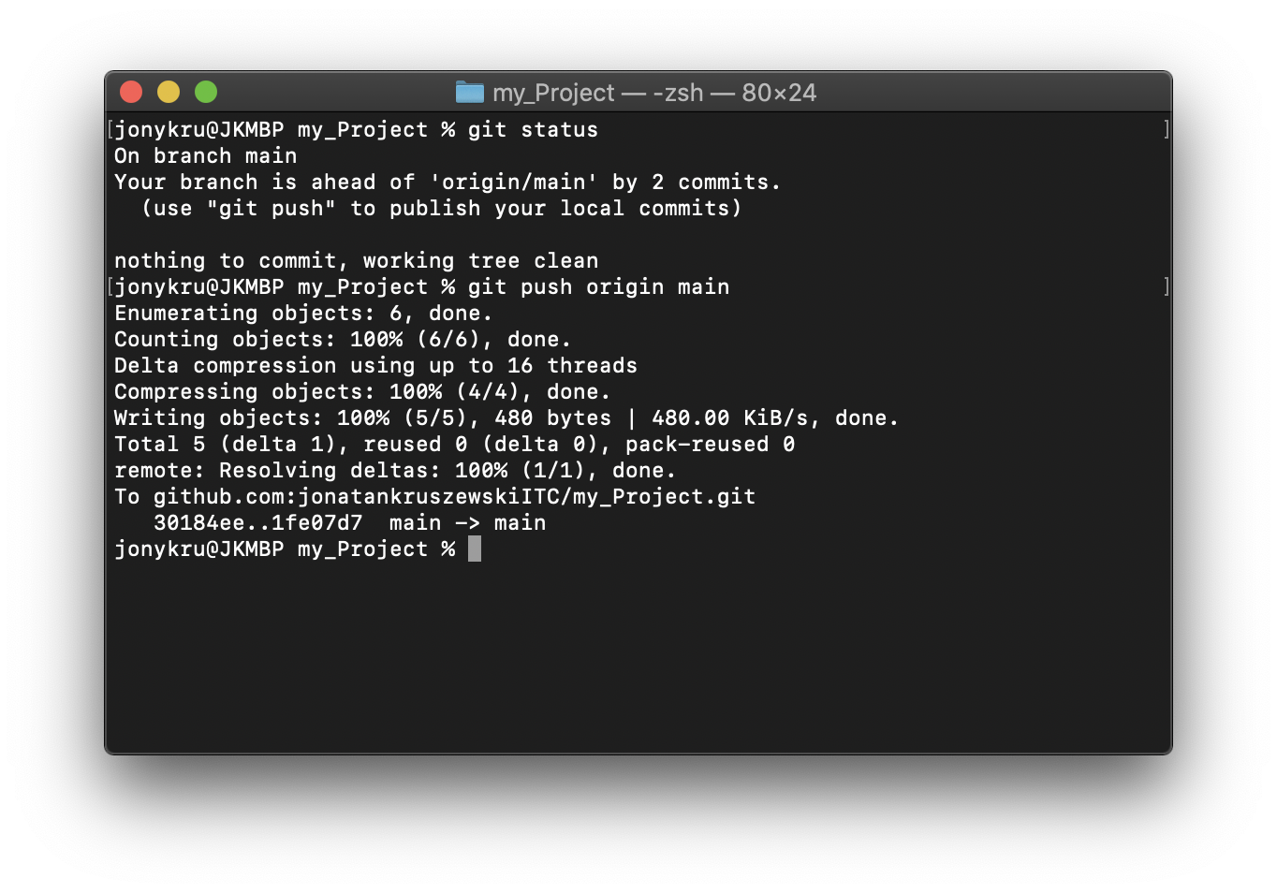
GIT push
To publish a commit, which means to push to the remote we need to run
git push <remote_name> <branch_name_on_remote>
In this case:
git push origin main
Be careful to push to a branch in the remote that already exists, because otherwise you will create it 😅 and you don’t want more branches without purpose

Slide 30
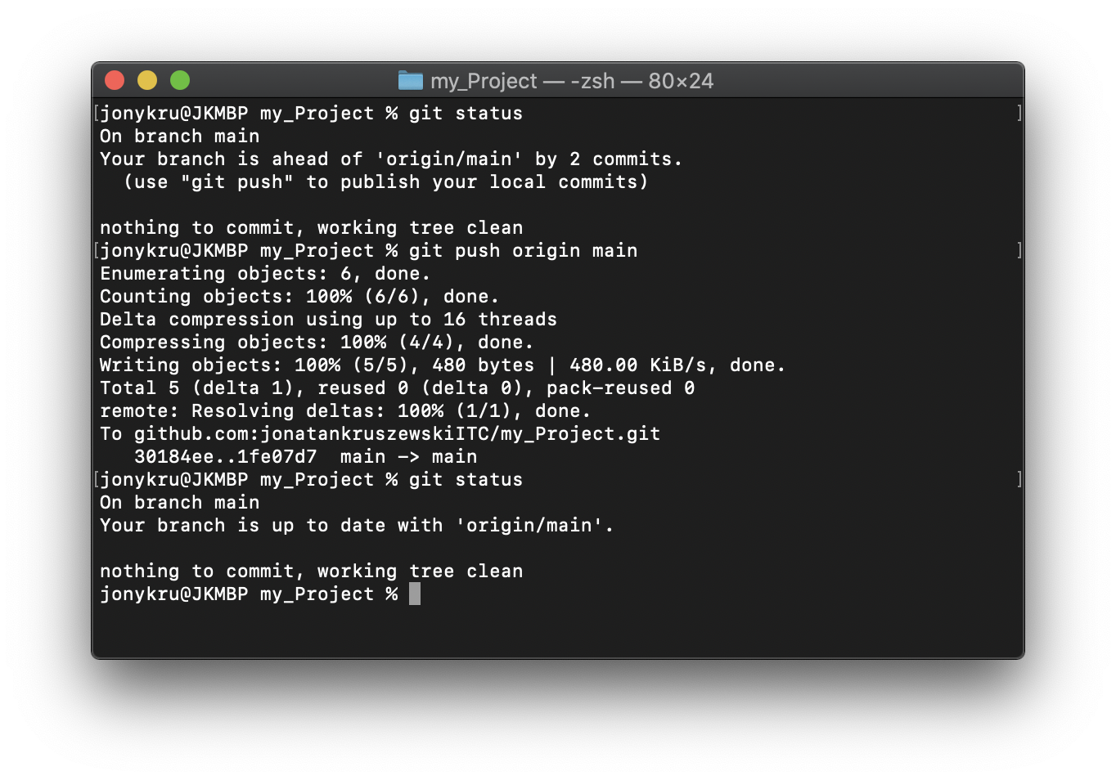
GIT push
After pushing, if you run git status again, you will have a clean working tree.
At this point you can start all over:
Perform modifications
Add those modifications to the staging area (git add)
Commit those modifications (git commit -m “message”)
Push those commits (git push)

Slide 31
GIT branch
How can we avoid to push to the wrong remote / branch?
Luckily, if you had set up the upstream branch of your local branch to match a remote branch, you can run only
git push
And it will be automatically pushed to that branch already set up. Let's check that using git branch

Slide 32
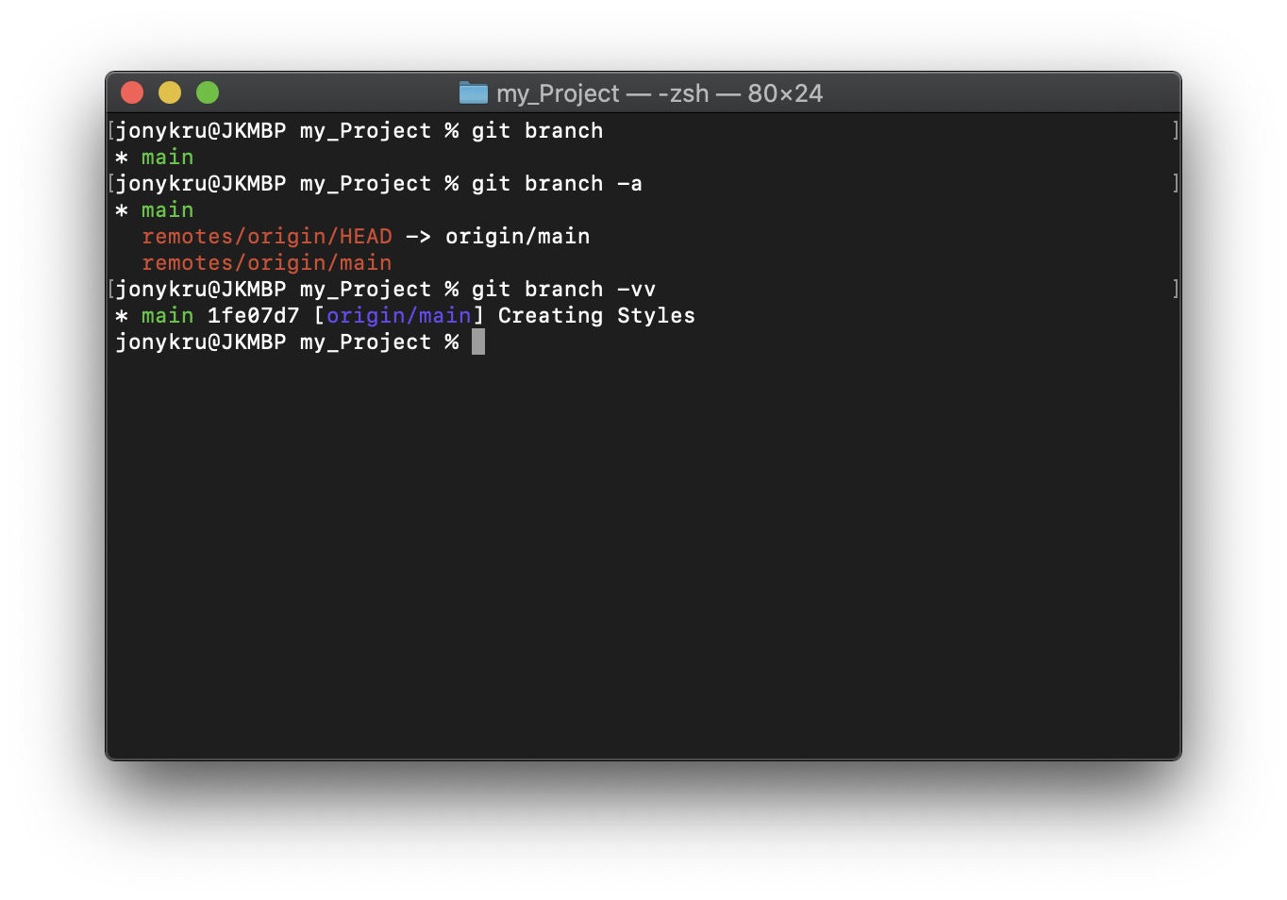
GIT branch
We can check information or perform modifications in the branch that we are standing by using git branch
To retrieve the name of our local branch:
git branch
To retrieve the names of all our branches:
git branch -a
To retrieve details of current branch:
git branch -vv

Slide 33
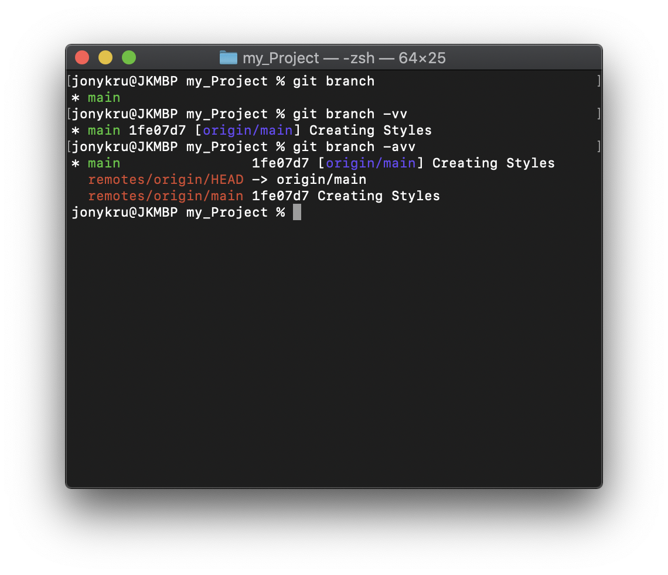
GIT branch
From all this commands we understand that:
Our local branch is named ‘main’ and that we are standing on it (the green one)
That our local branch pushes/pulls to origin/main and the latest commit id and message
That the HEAD (a pointer which indicates on which branch we stand) points to origin/main
There are branches in the remote (a branch named ‘main’).

Slide 34
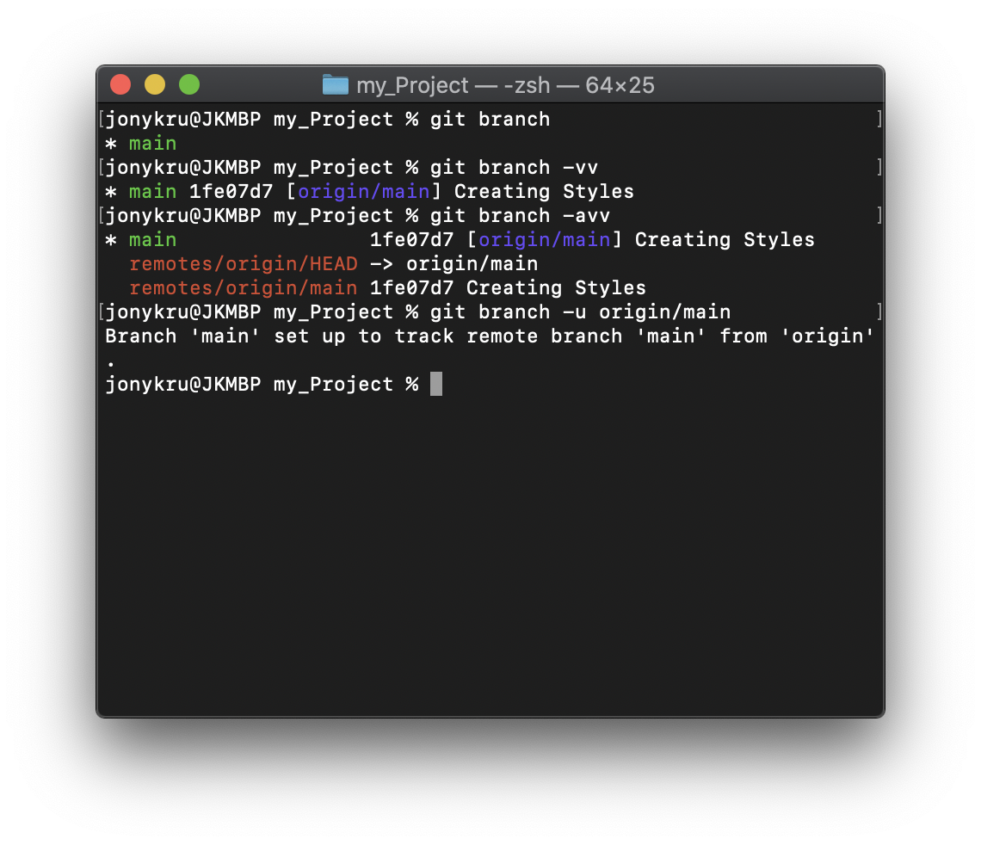
GIT branch --set-upstream
If for any reason our local branch ‘main’ doesn’t have as ‘upstream’ origin/main (or any other branch in the remote) we can fix it by assigning it:
git branch -u <remote_name>/<remote_branch>
In our case:
git branch -u origin/main
The -u stands for --set-upstream
Have in mind that in order for this command to work, the remote branch needs to exist before hand.

Slide 35
Wrapping up
We configured the Git Credentials
Initialized a repository (git init, git remote, git clone)
We learnt how to create organized commits (git add, git commit)
We learnt to fetch remote’s commits (git pull) and to publish local commits (git push). We also learnt to set the upstream branch if needed.
We learnt to check where are we standing (git branch, git status)

Slide 36
Resources
Git explained by Attlasian:
https://www.atlassian.com/git
Git basics:
https://www.freecodecamp.org/news/learn-the-basics-of-git-in-under-10-minutes-da548267cc91/
Intro to Git and GitHub for Beginners (Tutorial)
https://product.hubspot.com/blog/git-and-github-tutorial-for-beginners
A simple guide to git commands:
https://rogerdudler.github.io/git-guide/

